Slide 1
ANN-Lab 1
Tianxiao Zhao
Junxun Luo
Feiyang Liu
Jan 26th, 2017

Slide 2
The Lab is about
Construting feed forward networks
Training with error based learning methods
Its applications

Slide 3
Main Points
Feed forward networks
Classification
One layer perceptron
Two layer perceptron
Function approximation
Generalization

Slide 4
One Layer Delta-Rule Experiments on Seperable Training Data Set
Eta too small ---> Slow convergence
Eta too large ---> Weights fluctuation
Need to try to find an appropriate eta by experiments

Slide 5
One Layer Delta-Rule Experiments on Non-seperable Training Data Set
Errors increase significantly compared to the one on seperable training data set
Again:
Eta too small ---> Slow convergence
Eta too large ---> Weights fluctuation
Need to try to find an appropriate eta by experiments

Slide 6
Two Layer Delta-Rule Experiments on Seperable Training Data Set
Alpha increased ---> Convergence of higher probability since weights changes smoother
To Seperable training data, only one node in the hidden layer performs well
More than one node in the hidden layer does NOT help significantly

Slide 7
Two Layer Delta-Rule Experiments on Non-Seperable Training Data Set
Again: Alpha increased ---> Convergence of higher probability since weights changes smoother
To Non-Seperable training data, only one node in the hidden layer performs bad because the training data set is NOT linearly seperable
More than one node in the hidden layer helps significantly

Slide 8
Two Layer Delta-Rule Experiments on 8-3-8 Encoder
2 Hidden Layers ---> Not enough to reach 100% correctness
3 Hidden Layers ---> Can reach 100% correctness
4 Hidden Layers ---> Can reach 100% correctness, faster convergence than the 3 nodes in the hidden layer, but lower compression rate because of redundent encoding

Slide 9
Two Layer Delta-Rule Experiments on 8-3-8 Encoder
Taken from http://web.cs.hacettepe.edu.tr/~ilyas/Courses/BIL712/lec03-NeuralNetwork.pdf p34
After 5000 training epochs, the three hidden unit values encode the eight distinct inputs using the encoding shown on the right.

Slide 10
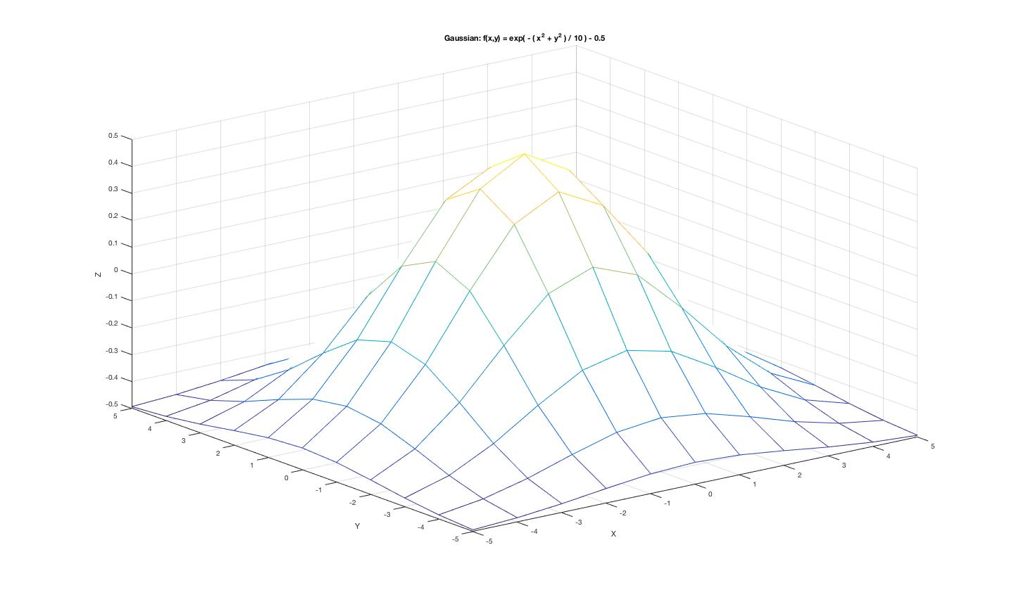
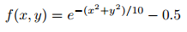
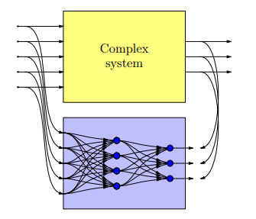
Gaussian Function Approximation

Slide 11
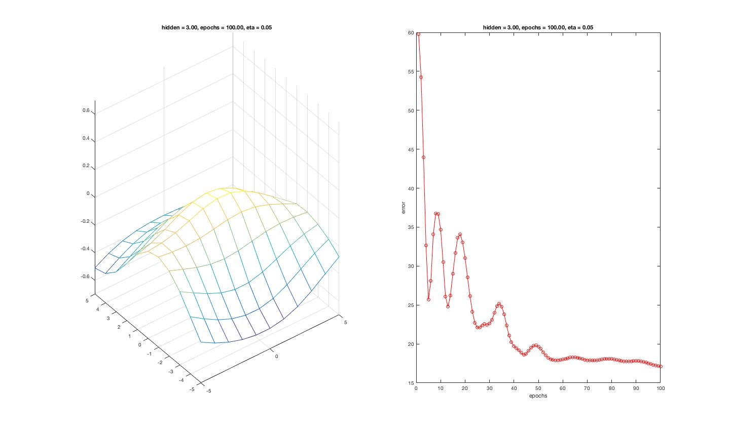
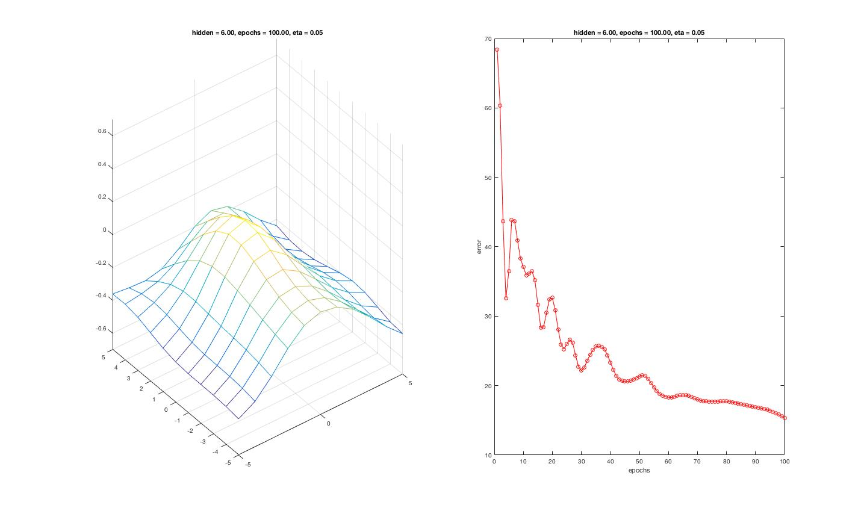
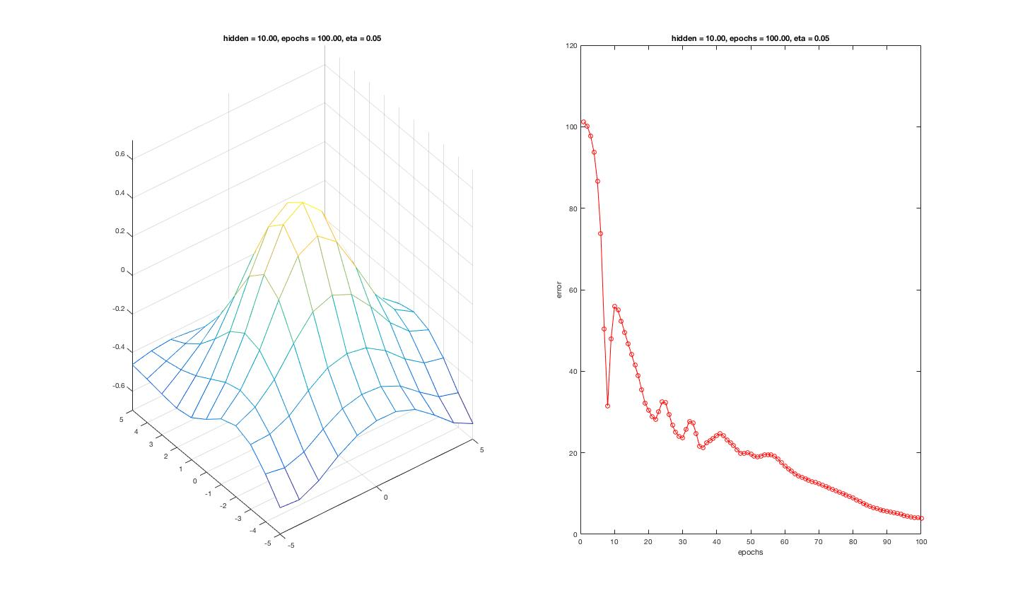
Gaussian Function Approximation
18.24
15.34
hidden = 3
hidden = 6
Conclusion:
More nodes in hidden layer, better performance on function approximation
Too much nodes in hidden layer may cause overfitting problem when working on system identification
(epochs = 100, eta = 0.05)
5.12
hidden = 10

Slide 12
Gaussian Function Approximation
Observation: More nodes in the hidden layer ---> Smaller the error

Slide 13
Gaussian Function Approximation
As Hidden Layers increase beyond 3 ---> Error decreases NOT so significantly as before
3 Hidden Layers might be the best number for Gaussian function approximation

Slide 14
Generalization on Non-Seperable Training Data Set
The figures above show the generalization process over epochs

Slide 15
Generalization on Non-Seperable Training Data Set
More training data ---> More generalizaed
More nodes in the hidden layer ---> Usually helps nothing when the number is larger than a paticular one based on our observations on the experiments ---> Too few nodes in the hidden layer cause under-fitting
NOTE that over-fitting have NOT been observed in this example although it should happen theoretically as the number of nodes in the hidden layer increases

Slide 16
Q & A

